Slide 1


CELL FOUNDRY
Meeting Title: Biweekly meet - 2
PAVIN SUMATHI PALANICHAMY · PRETHEBHA MUTHUKUMARAN · PRIYAM JHA
MENTOR: PROF. DR. MAGDA GREGOROVÁ
DATE: 22.10.2026

Slide 2

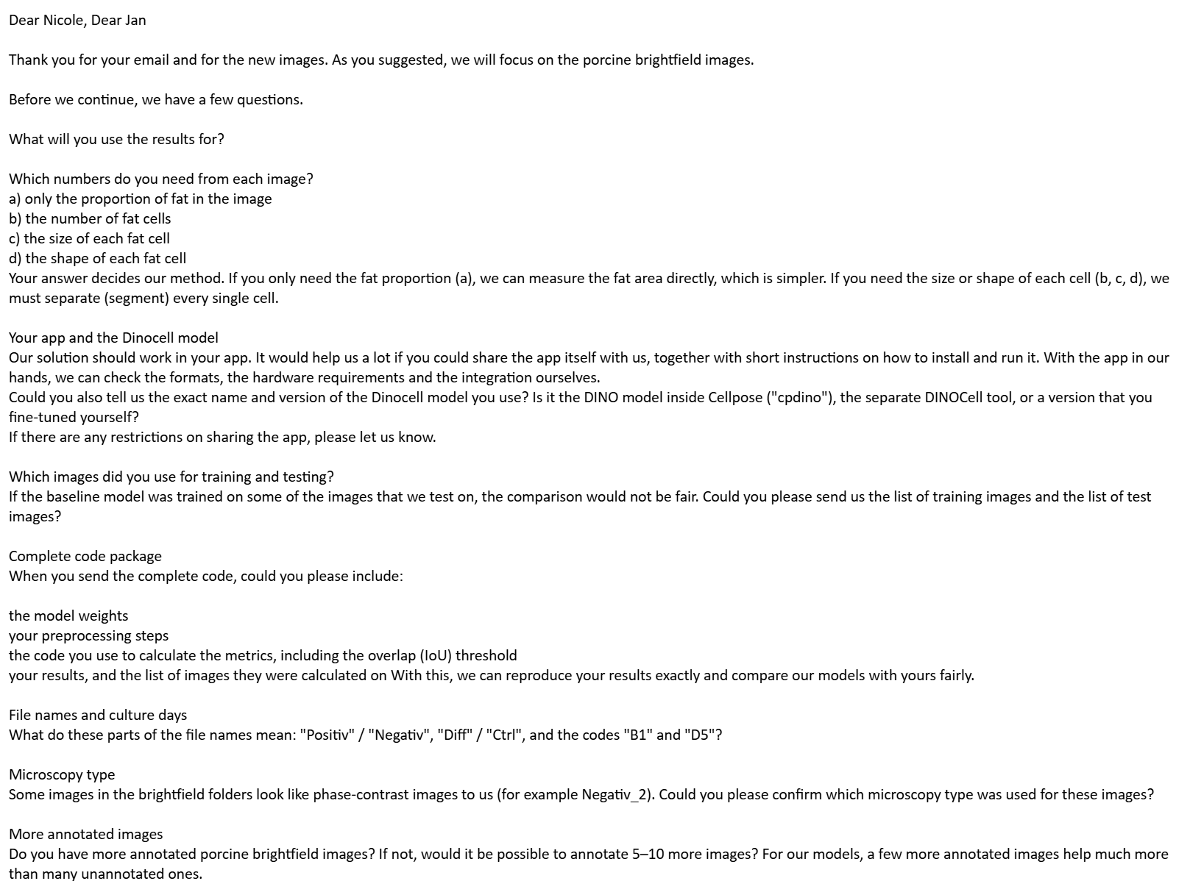
CELL FOUNDRY
Meeting Title: Biweekly meet - 2
Notes:
After the last meeting we wrote to Nicole and Jan with our open questions.
The most important question: which number do the users actually need? Only the proportion of fat in the image, or also the number, size and shape of each cell? This decides our method: for the fat proportion alone we could measure the fat area directly; for count, size or shape we must separate every single cell.
We also asked for their app and the exact DINOCell version, which images were used for training and testing (so our comparison is fair), the complete code package, what the file names mean, the microscope type, and whether more annotated images are possible.

Slide 3
CELL FOUNDRY
Meeting Title: Biweekly meet - 2
Notes:
After the last meeting we wrote to Nicole and Jan with our open questions.
The most important question: which number do the users actually need? Only the proportion of fat in the image, or also the number, size and shape of each cell? This decides our method: for the fat proportion alone we could measure the fat area directly; for count, size or shape we must separate every single cell.
We also asked for their app and the exact DINOCell version, which images were used for training and testing (so our comparison is fair), the complete code package, what the file names mean, the microscope type, and whether more annotated images are possible.

Slide 4
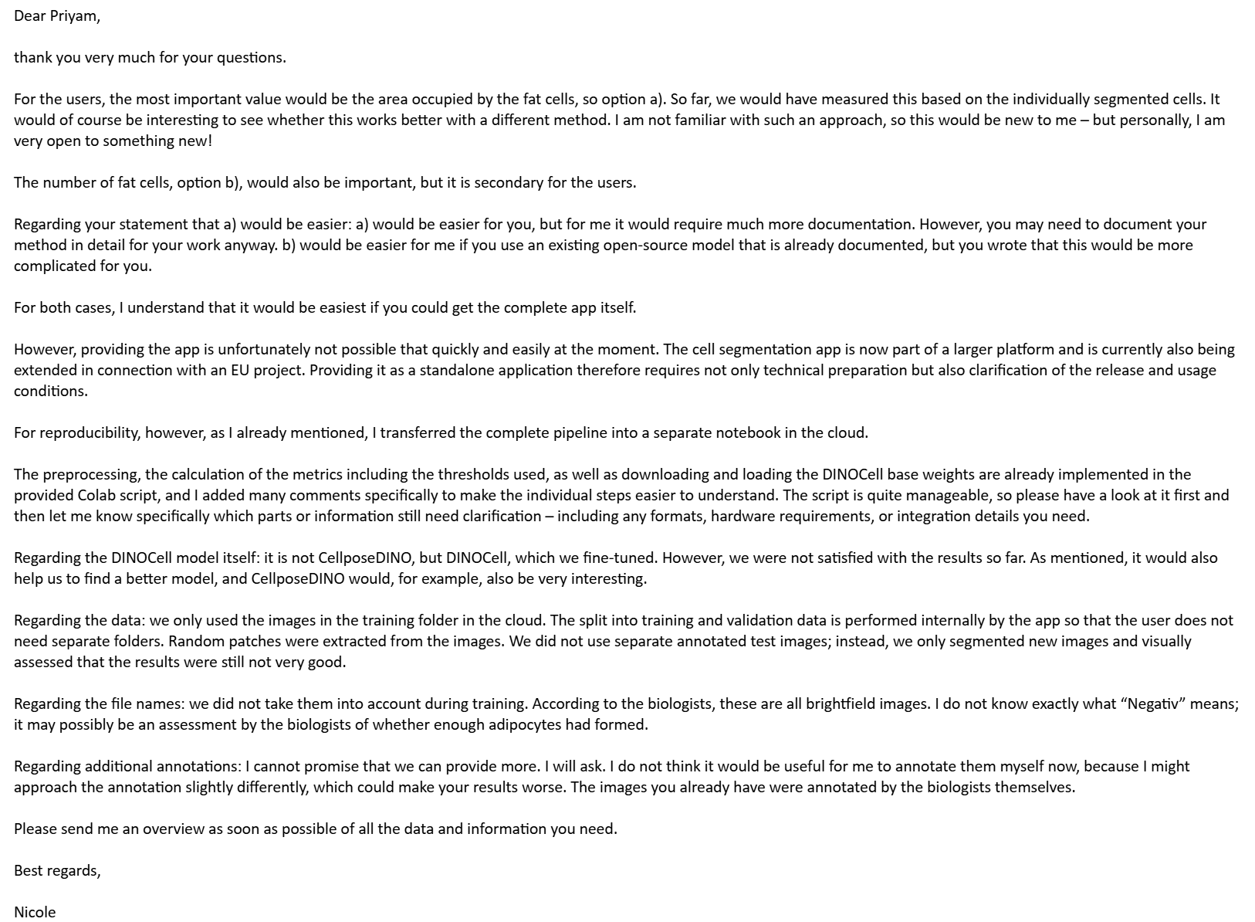
6 · UPDATE SINCE 8 OCTOBER
Nicole’s Answer (15 October)
CELL FOUNDRY
Meeting Title: Biweekly meet - 2
Notes:
Nicole answered on 15 October.
The key point: for the users, the most important number is the area covered by fat cells. The number of cells is also useful, but secondary. Today they get the area by segmenting every single cell. She is open to a different method if it works better.
The app cannot be shared at the moment, because it is part of a larger platform in an EU project. Instead, her Colab notebook contains the complete pipeline: preprocessing, metrics and loading the DINOCell weights.
Their baseline is DINOCell (not the DINO model inside Cellpose), fine-tuned by IMES. They are not satisfied with the results, and CellposeDINO would be interesting for them, which fits our zero-shot results.
They trained on all images in the training folder and have no separate test images. They judged new images by eye. All images are brightfield. More annotations are not promised, and Nicole does not want to annotate herself, because the biologists annotated the existing ones.
Consequence for us: fat-cell area becomes our primary metric, and we need our own held-out test images for a fair comparison.

Slide 5
6 · UPDATE SINCE 8 OCTOBER
Nicole’s Answer (15 October)
CELL FOUNDRY
Meeting Title: Biweekly meet - 2
Notes:
Nicole answered on 15 October.
The key point: for the users, the most important number is the area covered by fat cells. The number of cells is also useful, but secondary. Today they get the area by segmenting every single cell. She is open to a different method if it works better.
The app cannot be shared at the moment, because it is part of a larger platform in an EU project. Instead, her Colab notebook contains the complete pipeline: preprocessing, metrics and loading the DINOCell weights.
Their baseline is DINOCell (not the DINO model inside Cellpose), fine-tuned by IMES. They are not satisfied with the results, and CellposeDINO would be interesting for them, which fits our zero-shot results.
They trained on all images in the training folder and have no separate test images. They judged new images by eye. All images are brightfield. More annotations are not promised, and Nicole does not want to annotate herself, because the biologists annotated the existing ones.
Consequence for us: fat-cell area becomes our primary metric, and we need our own held-out test images for a fair comparison.

Slide 6
Communication with the IMES (Nicole)
PRIORITY: FAT PROPORTION (AREA)
SECOND PRIORITY (CELL COUNTS)
MOST IMPORTANT FOR USERS: THE AREA OCCUPIED BY FAT CELLS; COUNT IS SECONDARY.
VERY OPEN TO SOMETHING NEW IF AREA CAN BE MEASURED BETTER THAN FROM SEGMENTED CELLS.
ANY OPEN-SOURCE MODEL, IF IT CAN GO INTO THEIR APP (THE APP ITSELF CANNOT BE SHARED).
NO HELD-OUT TEST SET EXISTS; RESULTS CHECKED BY EYE AND JUDGED 'STILL NOT VERY GOOD'
NO TEST-SET NUMBER TO REPRODUCE
CELL FOUNDRY
Meeting Title: BiWeekly Meet - 2

Slide 7
Metrics : what is known
PIXEL LEVEL: DICE, IOU, PRECISION, RECALL. (FAT REGION)
INSTANCE LEVEL: PRECISION, RECALL AND F1 AT IOU 0.5. (INDIVIDUAL FAT CELLS)
COULD BE ADDED: RELATIVE AREA ERROR, THE PRIMARY OUTPUT.
No Benchmark yet
NO TEST SET. NO NUMBER FOR THEIR APP GIVEN
VALIDATION ON 12 RANDOM PATCHES FROM 6 HELD-OUT IMAGES (22 TRAIN, 6 VALIDATION).
No Explanation on the filenames
OUR INFERENCE: POSITIV / DIFF HAVE 182 TO427 ANNOTATED CELLS AND 11–27% AREA
NEGATIV / CTRL HAVE 2–5 CELLS AND ABOUT 0.1–0.3% AREA.
HOWEVER, IMES RESULTS DON’T DEPEND ON THE TYPE, BUT COULD BE USEFUL TO FIND DIFFERENTIATION STATES
CELL FOUNDRY
Meeting Title: BiWeekly Meet - 2

Slide 8
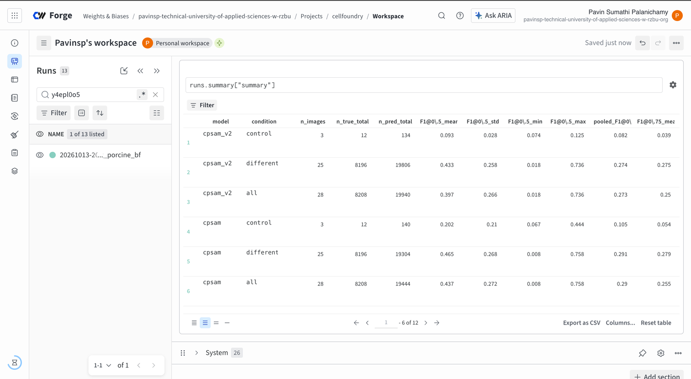
Experimental Tracking (WandB)
KEEPS A RECORD OF EVERY EXPERIMENTS RUN
IMES DATA IS NEVER UPLOADED TO THE SITE’S CLOUD
EACH RUN - TIMESTAMPED FOLDERS, NOTHING IS OVERWRITTEN
CELL FOUNDRY
Meeting Title: BiWeekly Meet - 2

Slide 9
Metric | cpdino | cpdino-vitb
F1@0.5 (mean) | 0.62 | 0.65
F1@0.75 | 0.38 | 0.37
Count error | +58% | −9%
Zero-shot results on porcine brightfield
FOR NOW: CPDINO-VITB BEST ZERO-SHOT OF THE FOUR WE TRIED, ON ONE IMAGE GROUP
CELL FOUNDRY
Meeting Title: BiWeekly Meet - 2

Slide 10
If area is the goal, why segment single cells?
A SEMANTIC TRACK FOR THE AREA METRIC
LABEL EVERY PIXEL FAT OR NOT FAT; AREA PROPORTION COMES DIRECTLY.
INSTANCE MASKS CAN BE TURNED INTO BINARY RESULTS → ANY PIXEL WITH A CELL NUMBER BECOMES "FAT"
CELL FOUNDRY
Meeting Title: BiWeekly Meet - 2

Slide 11
Models to Explore
If its Semantic track
U-Net
IT LABELS EVERY PIXEL (SEMANTIC). IT WAS MADE FOR BIOLOGY IMAGES WITH VERY FEW ANNOTATIONS.
nnU-Net
SETS PATCH SIZE, DEPTH, BATCH SIZE, PREPROCESSING, TRAINING SCHEDULE AND POST-PROCESSING AUTOMATICALLY FROM THE DATASET'S PROPERTIES.
PROBLEM: NEVER TESTED ON MICROSCOPY, CAN BE EXPLORED
IDEAS:
ADIPOCYTE U-NET 2.0 - FAT CELLS IN STAINED TISSUE SLIDES (HUMAN ADIPOSE TISSUE) → CUT THE HUGE SLIDE INTO OVERLAPPING TILES, CONVERT MASKS INTO POLYGONS AND MERGE THEM, SO CELLS AT TILE BORDERS ARE MEASURED WHOLE.
CELL FOUNDRY
Meeting Title: BiWeekly Meet - 2

Slide 12
Models
DINOCELL - BASELINE TO BE RUN TO PRODUCE THE RESULTS FIRST TO COMPARE WITH
IMES'S OWN FINE-TUNED RUN: VALIDATION F1 ABOUT 0.39–0.40 ON PATCHES, NO TEST SET
CELLPOSE-SAM - DESPITE A FAILURE MODEL:
FINE-TUNING WITH ONLY A FEW HUNDRED CELLS IMPROVED AP@0.5 FROM 0.50 TO 0.82
DINOV3 - BACKBONE OF OUR BEST ZERO-SHOT MODEL CPDINO
OMNIPOSE -CHEAP ZERO-SHOT A CELLPOSE VARIANT
ON BACTERIA CELLPOSE'S ERROR WHEN COMPARED TO OMNIPOSE'S IS HIGHER
CELL FOUNDRY
Meeting Title: BiWeekly Meet - 2

Slide 13
Instance Models
CELLSAM - FINETUNED ON CELLS (ON PHASE CONTRAST MICROSCOPY)
MICRO-SAM - FINETUNED FOR DIFFERENT MICROSCOPY IMAGES
BRIGHTFIELD STUDY, MICROSAM PERFORMED BETTER THAN CELLPOSE VARIANTS
STARDIST - LIGHTWEIGHT MODEL TRAINED ON ROUND CROWDED CELLS
INSTANSEG - U-NET (ALSO FAST AND PORTABLE - EASY INTEGRATION WITH THE APP) BUT ONLY TRAINED ON NUCLEI → CHECK WITH PORCINE DATA
PANOPTIC QUALITY (IDEA): GIVES ONE SCORE FOR A TASK THAT HAS BOTH "REGIONS" (SEMANTIC) AND "OBJECTS" (INSTANCE)
CELL FOUNDRY
Meeting Title: BiWeekly Meet - 2

Slide 14
The order
  cpdino-vitb (fine-tune).
  cpdino (zero-shot and thenfine-tune).
  DINOCELL (FINE-TUNE): IMES'S OWN MODEL, SO INTEGRATION IS NO ISSUE;
  MICRO-SAM
  U-NET / NNU-NET (SEMANTIC).
  OTHERS:
    OMNIPOSE,
    CELLSAME
    STARDIST,
    INSTANSEG.
    OMNIPOSE
  A REPLACEMENT MUST BE OPEN SOURCE AND INTEGRABLE INTO THE APP, NOT JUST WIN A BENCHMARK.
CELL FOUNDRY
Meeting Title: BiWeekly Meet - 2

Slide 15
For the next two weeks
  ZERO-SHOT ON THE FIRST 3 TO 5 MODELS, PLUS A SEMANTIC BASELINE IF AGREED
  ERROR ANALYSIS: WHY EACH MODEL WORKS OR FAILS
  FIRST FINE-TUNE OF THE BEST MODEL ON THE FIXED SPLIT
  SHORT SUMMARY AND ANY FURTHER QUESTIONS TO IMES
CELL FOUNDRY
Meeting Title: BiWeekly Meet - 2

Slide 16
6 · UPDATE SINCE 8 OCTOBER
Our Questions to IMES
What we asked
  Which numbers matter: fat proportion, cell count, size or shape?
  Can we get your app and the exact DINOCell version?
  Which images were used for training and for testing?
  Full code package: weights, preprocessing, metric code, results
  What do the file names mean (Positiv/Negativ, Diff/Ctrl, B1/D5)?
  Which microscope type, and are more annotated images possible?
CELL FOUNDRY
Meeting Title: Biweekly meet - 2
Notes:
After the last meeting we wrote to Nicole and Jan with our open questions.
The most important question: which number do the users actually need? Only the proportion of fat in the image, or also the number, size and shape of each cell? This decides our method: for the fat proportion alone we could measure the fat area directly; for count, size or shape we must separate every single cell.
We also asked for their app and the exact DINOCell version, which images were used for training and testing (so our comparison is fair), the complete code package, what the file names mean, the microscope type, and whether more annotated images are possible.

Slide 17
6 · UPDATE SINCE 8 OCTOBER
Nicole’s Answer (15 October)
What we learned
  Most important: the area covered by fat cells; cell count is second
  The app cannot be shared yet (part of an EU platform)
  Her Colab notebook is the complete pipeline
  Baseline = DINOCell fine-tuned by IMES, not CellposeDINO
  IMES is not happy with it; CellposeDINO is “very interesting”
  Trained on all images, no separate test images
  All images are brightfield; more annotations not promised
→ Fat-cell area becomes our main metric
CELL FOUNDRY
Meeting Title: Biweekly meet - 2
Notes:
Nicole answered on 15 October.
The key point: for the users, the most important number is the area covered by fat cells. The number of cells is also useful, but secondary. Today they get the area by segmenting every single cell. She is open to a different method if it works better.
The app cannot be shared at the moment, because it is part of a larger platform in an EU project. Instead, her Colab notebook contains the complete pipeline: preprocessing, metrics and loading the DINOCell weights.
Their baseline is DINOCell (not the DINO model inside Cellpose), fine-tuned by IMES. They are not satisfied with the results, and CellposeDINO would be interesting for them, which fits our zero-shot results.
They trained on all images in the training folder and have no separate test images. They judged new images by eye. All images are brightfield. More annotations are not promised, and Nicole does not want to annotate herself, because the biologists annotated the existing ones.
Consequence for us: fat-cell area becomes our primary metric, and we need our own held-out test images for a fair comparison.

Slide 18
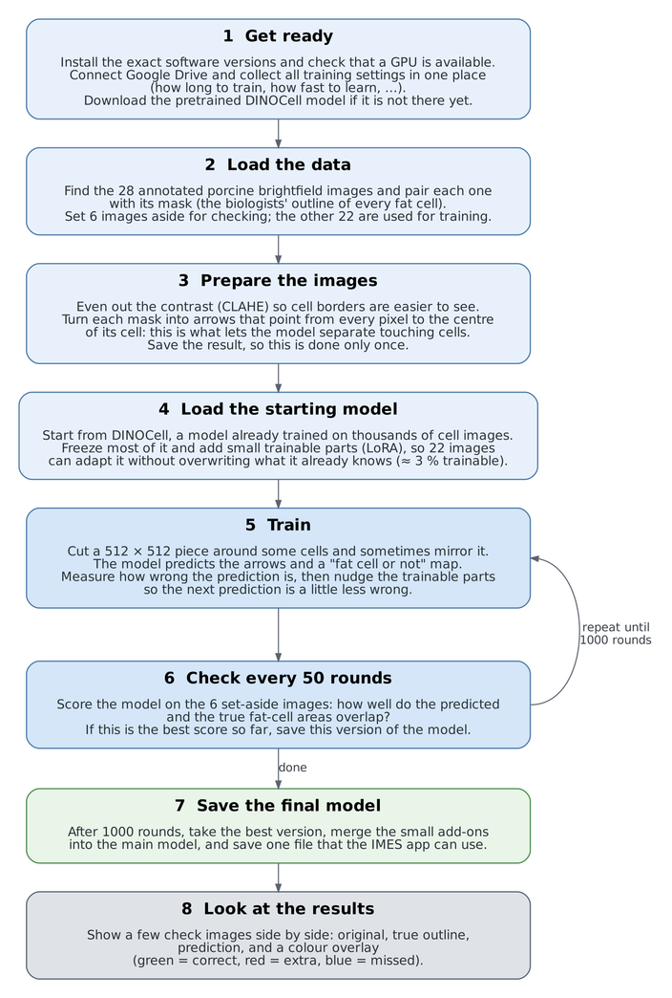
6 · UPDATE SINCE 8 OCTOBER
IMES Training Pipeline in 8 Steps
Prepare (steps 1–4)
  Load the 28 annotated images; keep 6 aside for checking
  Even out the contrast (CLAHE) so cell borders are easier to see
  Turn each mask into arrows pointing to the cell centre: this is how touching cells get separated
  Start from the pretrained DINOCell; train only small add-ons (LoRA, about 3 % of the model)
Train (steps 5–6)
  1000 rounds: one 512 × 512 piece per round; the model predicts arrows + a fat map and is corrected
  Every 50 rounds: score on the 6 check images and keep the best version
Finish (steps 7–8)
  Merge the add-ons, save one model file for the IMES app, show example results
CELL FOUNDRY
Meeting Title: Biweekly meet - 2
Notes:
We studied Nicole's notebook line by line and summarised it in eight steps.
Prepare: the notebook loads the 28 annotated porcine images and keeps 6 aside to check progress. It evens out the contrast with CLAHE. The key trick, which comes from Cellpose: each mask is turned into arrows that point from every pixel to the centre of its cell. Where two cells touch, the arrows point in opposite directions, so the model can split them. Training starts from DINOCell, which was already trained on thousands of cell images. Most of it is frozen; only small add-ons called LoRA, about 3 % of the model, are trained, so 22 images cannot overwrite what it already knows.
Train: 1000 rounds. Each round cuts one 512 by 512 piece around some cells, the model predicts the arrows and a fat-or-not map, and it is corrected a little. Every 50 rounds it is scored on the 6 check images, and the best version is kept.
Finish: the add-ons are merged into the model and saved as one file, which is what the IMES app uses. At the end the notebook shows a few example predictions.

Slide 19
6 · UPDATE SINCE 8 OCTOBER
What IMES’s Code Does Well
Reproducible
Correct data handling
Sensible training
  Fixed software versions
  All settings in one place, saved with every run
  Fixed random seeds
  Each run in its own folder, nothing overwritten
  Split by whole image, so no leakage
  Arrows flipped correctly when images are mirrored
  Contrast computed on the full image
  Same normalisation as the pretrained model
  LoRA: small changes, right for only 22 images
  Safe, strict loading of model weights
  Training can resume after a crash
  One merged model file for the app
→ We keep all of these in our own pipeline
CELL FOUNDRY
Meeting Title: Biweekly meet - 2
Notes:
First the good news: the notebook is well engineered. We found about 30 good practices; here are the main ones in three groups.
Reproducible: important packages are pinned to exact versions; all settings are in one place and saved with every run; random seeds are fixed; and every run gets its own folder, so old results are never overwritten.
Correct data handling: the train/check split is done on whole images before cutting pieces, so no part of a check image is ever seen in training. When an image is mirrored, the arrows are mirrored too, which is a classic bug that they avoid. Contrast is computed on the full image, and the images are normalised exactly like the pretrained model expects.
Sensible training: LoRA only allows small changes, which is the right choice for 22 images. Weights are loaded safely and strictly, so a wrong setting fails loudly. Training can resume after Colab disconnects, and at the end the add-ons are merged into one plain model file for the app.
We will copy all of these practices into our own pipeline.

Slide 20
6 · UPDATE SINCE 8 OCTOBER
What We Would Look Into
1 · Big fat cells get cut short
2 · Colour channels handled differently
  To turn arrows into cells, every pixel “walks” to its cell centre
  With IMES’s settings it can walk at most about 40 px
  Our check on the 28 images: 8.9 % of cells, holding 20.7 % of the fat area, reach further
  Fix: scale the arrows ×5 → reach 200 px. One number, no retraining
  Original DINOCell: image turned grey first, then contrast (CLAHE)
  IMES notebook: contrast on red, green and blue separately
  Our check: all 28 images are colour (0 of 28 grey), so the two really differ
  Proposal: keep IMES’s way for the baseline, test grey-first separately
→ Proposals only: IMES’s baseline stays as they built it; each change is tested on its own
CELL FOUNDRY
Meeting Title: Biweekly meet - 2
Notes:
Two technical points we would look into. Both are proposals; IMES's baseline stays exactly as they built it, and each change becomes its own labelled test.
Point 1, big fat cells get cut short. The model does not draw cells directly. It predicts, for every pixel, an arrow to the centre of its cell. A last step then lets every pixel walk along the arrows; pixels that meet at the same centre become one cell. With IMES's settings each step is only 0.2 pixels and there are 200 steps, so a pixel can travel at most about 40 pixels. Pixels further from the centre never arrive and are dropped, so big cells come out too small. That matters because fat area is the main readout. We measured the real cells: 8.9 % of the cells reach further than 40 pixels, but they hold 20.7 % of the fat area. The fix is one number: multiply the arrows by 5 (Cellpose's own convention), which gives a reach of 200 pixels, with no retraining. In a synthetic test with perfect arrows, a cell of radius 60 px kept only 59 % overlap with IMES's setting and 100 % with the fix.
Point 2, colour channels. The original DINOCell turns the image grey first and then improves the contrast. Nicole's notebook improves the contrast on red, green and blue separately. If the images were grey, both would give the same result, but we checked: all 28 images contain colour. So the inputs differ from what DINOCell was trained on. We keep IMES's version for the baseline and test the grey-first version as a separate experiment.

Slide 21
6 · UPDATE SINCE 8 OCTOBER
How IMES Checks Its Model
1 · Checks use small patches
2 · No separate test images
  Every 50 rounds: scored on 12 small pieces (512 × 512) of the 6 check images
  That is only about 25 % of each image, mostly around cells
  Empty background is rarely checked, so false detections are missed
  Proposal: score whole images, the same way for every model
  The best version is picked on the same 6 images that are reported
  So the reported score looks better than it really is
  The app model saw all 28 images, so it cannot be tested fairly on them
  Proposal: fixed split, e.g. 18 train / 4 check / 6 test, test used once
→ Suggestions for Potential Split - 18 / 4 / 6 split, or k-fold cross-validation?
CELL FOUNDRY
Meeting Title: Biweekly meet - 2
Notes:
The biggest gap in the notebook is not in training but in how the model is checked.
Point 1, patches. Every 50 rounds the notebook scores the model on 12 small 512 by 512 pieces, two from each of the 6 check images. Together that is only about a quarter of each image, and the pieces are centred on cells. Empty background is hardly ever checked, so false detections in empty areas are under-counted. That is fine for watching training, but not for reporting. Our proposal: report only whole-image results, with the same scoring code for every model.
Point 2, no test images. The best checkpoint is chosen on the same 6 images whose score is then reported. If you pick the best of 20 noisy scores, you systematically pick a lucky one, so the reported number is optimistic. In addition, the model in the IMES app was trained on all 28 images, so testing it on any of them measures memory, not real performance.
Our proposal: a fixed, stratified split, for example 18 training, 4 check and 6 test images, with at least one control and one difficult image in the test set. The test images are used once, at the end, for all models. The alternative is k-fold cross-validation, which uses every image for testing once but costs more training runs. Question for the mentor: which do you prefer?

Slide 22
6 · UPDATE SINCE 8 OCTOBER
Better Evaluation: Fat-Cell Area
New metrics (IMES’s request)
One scoring script for every model
  Fat % = share of the image covered by fat cells
  Fat % error = predicted minus true, in percentage points
  Foreground Dice = overlap of predicted and true fat area (1 = perfect)
  Kept: cell count error and F1 at IoU 0.5 / 0.7 / 0.75
  score_masks_v2.py: the same metric code for every model
  run_batch_v2.py: runs models on a whole folder and scores them
  Checked against hand-calculated answers; reproduces the 18 Oct numbers exactly
  Ready as the baseline for the models the team picks after reading their papers
→ Pull request open on GitHub (part of issue #1), waiting for review
CELL FOUNDRY
Meeting Title: Biweekly meet - 2
Notes:
Nicole told us that the area covered by fat cells is the most important number for the users. Until now our scoring only measured how well single cells are found. So we added the fat area to the evaluation.
Fat percent is simply the share of the image covered by fat cells, for the true mask and for the prediction. The fat percent error is predicted minus true, in percentage points: plus means the model sees too much fat, minus too little. Foreground Dice measures how well the predicted and true fat areas overlap; 1 is perfect. We kept everything we had before: the cell count error and F1 at several overlap levels, now including 0.7, which the mentor minutes mention.
We also built one set of scoring scripts that every model goes through: score_masks_v2 holds the single metric definition, run_batch_v2 runs the models on a whole folder and scores them. The maths is checked by an automatic test with hand-calculated answers, and a fresh run reproduces our earlier numbers from 18 October exactly. This is the baseline pipeline for the models the team chooses after reading the papers: same images, same code, same numbers. The pull request is open on GitHub and waiting for review.

Slide 23
6 · UPDATE SINCE 8 OCTOBER
Zero-Shot Results with Fat-Cell Area
Model
Fat % error
Typical miss
Fat-area Dice
Cell F1@0.5
Count error
cpsam_v2
cpsam
cpdino
cpdino-vitb
−6.6 pp
−4.6 pp
−1.4 pp
−0.1 pp
6.6 pp
5.6 pp
3.7 pp
4.5 pp
0.66
0.65
0.76
0.73
0.43
0.47
0.62
0.65
+141 %
+135 %
+58 %
−9 %
25 differentiated porcine brightfield images · true fat area ≈ 19.7 % of each image · zero-shot, default settings · pp = percentage points
  Best on fat area: cpdino (smallest typical miss, best Dice). Best on cells: cpdino-vitb
  Six hard images (Positiv_21–26) break most models: up to 3,300 “cells” instead of about 400
  Next: base DINOCell and the IMES fine-tuned baseline through the same scoring
CELL FOUNDRY
Meeting Title: Biweekly meet - 2
Notes:
These are our four zero-shot Cellpose models, re-scored with the new metrics. Same masks as last time; only the scoring is new, and the old numbers are reproduced exactly.
On average about 20 % of each differentiated image is fat.
Fat percent error is the bias: cpsam_v2 sees 6.6 points too little fat, which is roughly a third of the fat. cpdino-vitb is almost perfect on average, minus 0.1 points.
But the typical miss tells a different story: cpdino-vitb still misses by 4.5 points per image, because over- and under-estimates cancel in the average. cpdino has the smallest typical miss, 3.7 points, and the best overlap of fat area, Dice 0.76. So: cpdino is best on fat area, IMES's main readout, while cpdino-vitb is best at finding single cells (F1 0.65) and at the cell count (only 9 % too few). Which model is 'best' depends on the metric, which is why agreeing on the metric first matters. With 25 images the difference between cpdino and cpdino-vitb is small and not yet tested statistically.
Six images, Positiv 21 to 26, break three of the four models: they predict up to 3,300 objects where about 400 cells are annotated; probably they outline single lipid droplets instead of whole cells. These images must be spread over train, check and test in our split.
Next: run base DINOCell and the IMES fine-tuned baseline through exactly the same scoring.

Slide 24
6 · UPDATE SINCE 8 OCTOBER
Run Tracking: From PDF to W&B
Before: one PDF per run
Now: Weights & Biases (W&B)
  Written by hand after each run
  Hard to compare runs side by side
  Settings and code version get lost
  One run per model, logged by the script
  Summary = average over all images
  Settings, versions, git commit saved
Only numbers and tables go to W&B — never images or masks
Test project: cellfoundry-test · final runs go to a new project after the scoring PR is merged
CELL FOUNDRY
Meeting Title: Biweekly meet - 2
Notes:
As we discussed last time, we stopped writing a PDF report for every run and switched to Weights & Biases.
Before: after each run someone had to put the numbers into a PDF by hand. Comparing two runs meant opening two PDFs, and it was easy to lose which settings and which code version produced a number.
Now: the scoring script logs each model as one W&B run, automatically. The run summary is the average over all images (and separately for differentiated and control images), plus a per-image table. With every run W&B stores the settings, the package versions and the git commit of our code, so every number can be traced back.
Data safety: only numbers and tables leave the laptop. Images and masks stay local or on THWS storage.
Right now we use a test project, cellfoundry-test, to check that everything works. When the scoring PR is merged into main, we re-run from the repository into a new, clean project, and those are the numbers we will report.

